Slide 1
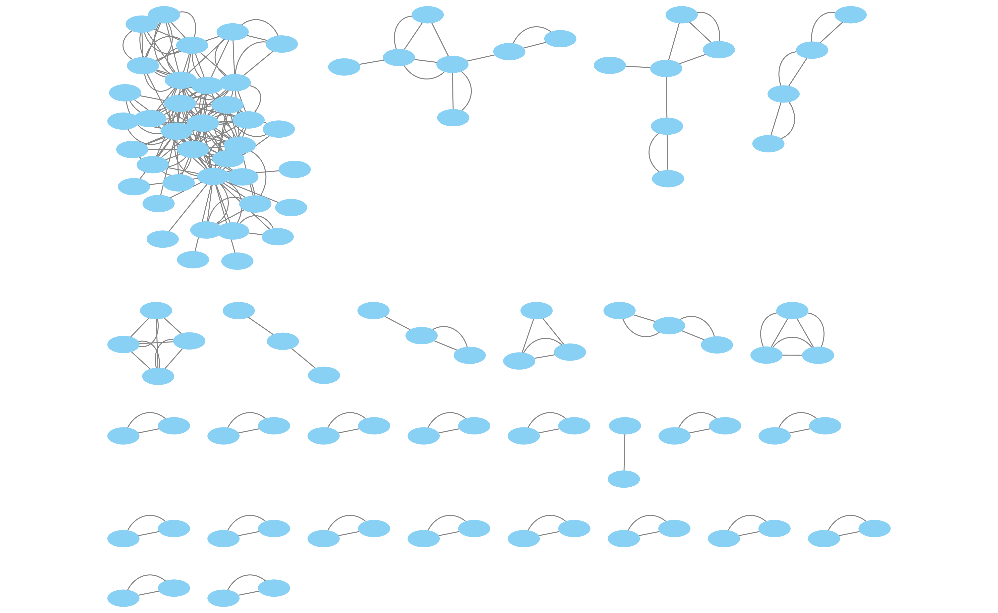
a
b
X617
X612
X613
X611
X605
X614
X608
X606
Singletons: (X607, 28), (X609, 30), (X610, 29)

Slide 2
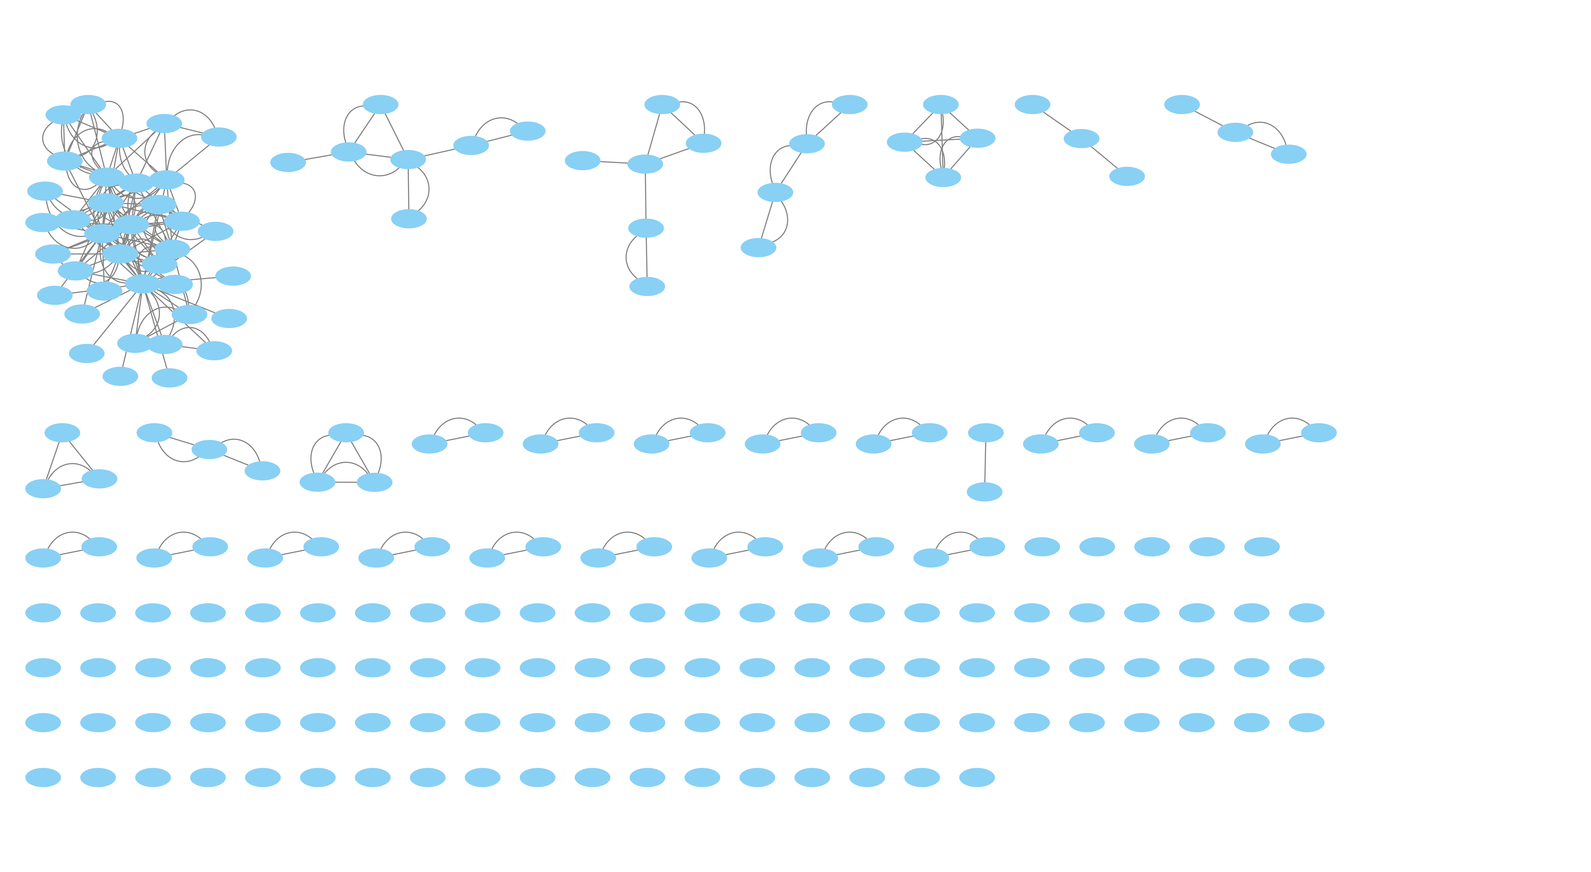
a
b
X617
X612
X613
X611
X605
X614
X608
X606
X607
X610
X609
Singletons: (X607, 28), (X609, 30), (X610, 29)

Slide 3
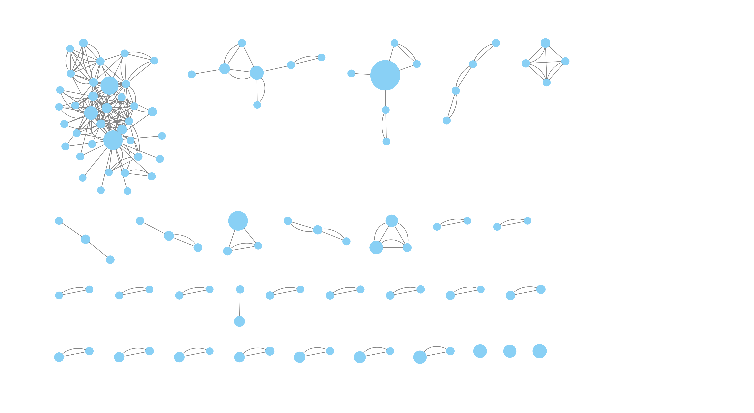
a
b
X617
X612
X613
X617
X612
X613
X611
X605
X614
X611
X605
X608
X606
X607
X610
X609
X614
X608
X606
X610
X609
X607
Singletons: (X607, 28), (X609, 30), (X610, 29)

Slide 4
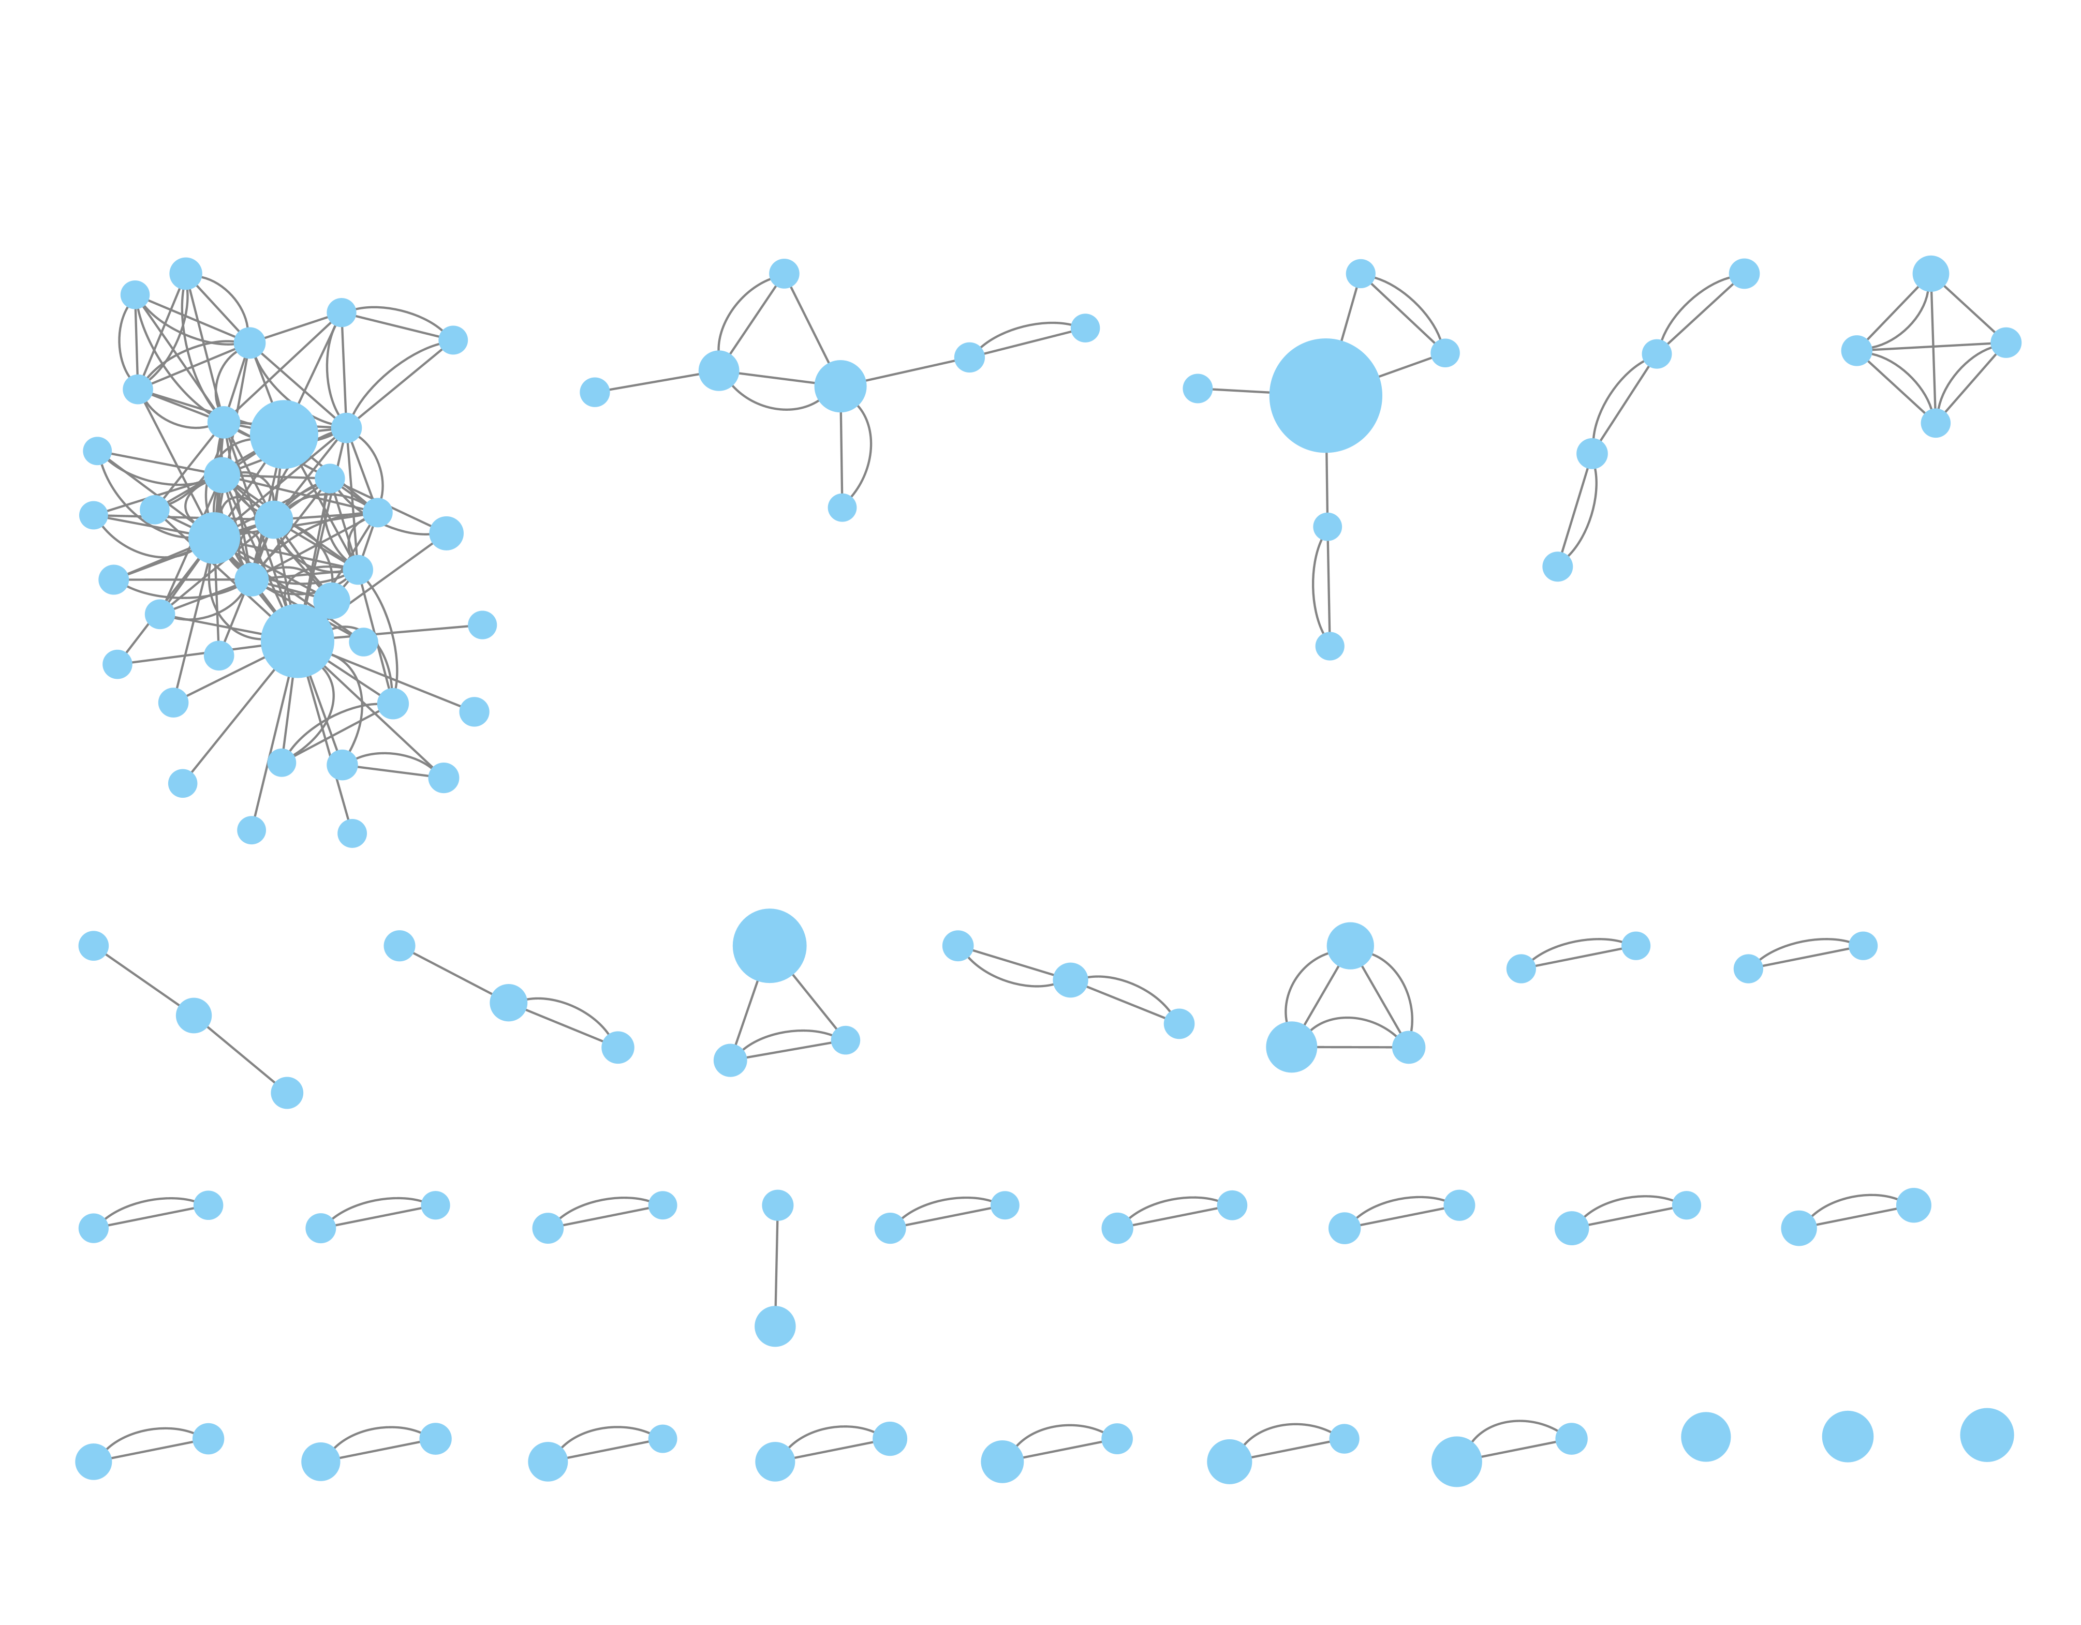
a
b
X617
X612
X613
X631
X611
X605
X614
X633
X608
X632
X606
X610
X609
X607

Slide 5
